Slide 1
SafeSea: SDG-Based Smart Maritime Boundary Protection and Environmental Monitoring System Using Object-Oriented Analysis and Design
CSA1110- OBJECT ORIENTED ANALYSIS AND DESIGN
PRESENTED BY:
GUIDED BY:
TEJASWINI M (192411079)
SHARU PRIYA M (192411116)
PROF DR. MANIMARAN A
VISHALSAI BJ (192320012)
D CHAITANYA (192320028)
YUVASRI S (192521032)

Slide 2


INTRODUCTION
SafeSea is an intelligent maritime boundary monitoring and navigation system designed to prevent fishermen from unintentionally crossing international boundaries
It utilizes GPS technology and real-time data processing to continuously monitor boat position, speed, and direction
The system analyzes movement patterns and predicts the risk of boundary violations for safer navigation
A decision-support mechanism classifies regions into safe, warning, and restricted zones to support timely actions
When high-risk situations are detected, the system provides visual alerts, alarm sounds, multilingual voice warnings, and navigation guidance to ensure secure maritime operations

Slide 3

PROBLEM STATEMENTS
Lack of real-time awareness of international maritime boundaries leads to accidental crossings
Existing navigation systems provide limited monitoring and predictive capabilities
Absence of intelligent alert mechanisms affects timely decision-making
Language barriers reduce the effectiveness of emergency communication
There is a need for a scalable and user-friendly system that enhances maritime safety

Slide 4

OBJECTIVE
“To develop an intelligent and user-centric maritime navigation system that provides real-time monitoring, risk analysis, multilingual alerts, and navigation guidance to improve fishermen safety and prevent accidental boundary crossings”

Slide 5
LITERATURE REVIEW
Year | Authors | Title of Study | Methodology | Key Contributions | Limitations
2025 | T. Menakadevi et al. | Smart Marine Border Monitoring and Alert System for Fishermen | IoT, GPS and GSM-based monitoring | Provides real-time location tracking and boundary alerts for fishermen | Limited predictive analysis capabilities
2025 | T. Miller et al. | A Systematic Review of AI-Driven Threat Detection and Maritime Security | Systematic review following PRISMA guidelines | Explores AI applications for maritime safety and security | Focuses mainly on cybersecurity aspects
2025 | S.M. Hassan | Application of Artificial Intelligence in Marine Engine Control Systems | AI-based control and analysis | Improves efficiency and reliability of marine operations | Limited focus on boundary monitoring
2026 | G.M. Karthik et al. | Smart Maritime Safety System for Indian Fishermen Using GPS and LoRa Communication | GPS and LoRa-based communication system | Enhances safety and communication for fishermen near maritime borders | Lack of cloud-based monitoring and analytics
2026 | IJERT Research Group | Wave Sense: Smart Marine Boat Tracking and Fishing Assistance System Using IoT and AI | IoT sensors, GPS, cloud monitoring and AI | Provides real-time tracking and environmental monitoring for fishing boats | Increased implementation complexity

Slide 6
MODULE 1
Smart Fisherman Registration and Voyage Management
Registers fishermen with personal details, fishing license information, and vessel identification.
Maintains a centralized database of fishermen, boats, and voyage records for easy management.
Allows fishermen to create, update, and manage fishing trips before departure.
Verifies user identity through secure authentication and role-based access (Fisherman, Coast Guard, Administrator).
Stores previous voyage history to support future navigation and performance analysis.

Slide 7
MODULE 2
Navigation and Safe Route Management
Uses GPS and digital maps to determine the current location of fishing vessels.
Generates optimized navigation routes based on destination, weather conditions, and sea traffic.
Integrates real-time weather forecasts, ocean current information, and tidal conditions for safer navigation.
Continuously updates navigation paths when environmental conditions change.
Provides intelligent route recommendations to minimize travel time, fuel consumption, and navigation risks.

Slide 8
MODULE 3
Maritime Boundary Intelligence and Hazard Detection
Continuously monitors vessel location with respect to international maritime boundaries using geofencing techniques.
Detects restricted fishing zones, protected marine areas, and unauthorized border crossings.
Performs AI-based risk assessment by analyzing weather patterns, wave height, and vessel movement.
Predicts possible navigation hazards and unsafe fishing locations before they become critical.
Provides visual boundary indicators and warning notifications to help fishermen avoid violations.

Slide 9
MODULE 4
Emergency Communication and Decision Support
Automatically generates alerts when vessels approach restricted maritime boundaries or hazardous regions.
Sends SOS notifications with real-time GPS coordinates during emergency situations.
Shares vessel location and emergency information with Coast Guard stations and emergency response teams.
Recommends the safest evacuation routes and nearby rescue stations based on the vessel's location.
Maintains an emergency communication log for future investigation and operational analysis.

Slide 10
MODULE 5
Navigation Analytics, Reporting and System Evaluation
Records complete voyage details, navigation routes, alerts, and emergency events for analysis.
Generates graphical reports showing navigation efficiency, fuel usage, and boundary violation statistics.
Analyzes historical navigation data to identify frequently used routes and high-risk maritime zones.
Evaluates overall system performance through usability testing, reliability testing, and navigation accuracy.
Supports continuous system improvement using user feedback, performance metrics, and predictive analytics.

Slide 11


SDG ALIGNMENT
SDG 9
Industry, Innovation and Infrastructure
Uses GPS, real-time dashboards, AI risk scoring, and OOAD-based modular system design.
SDG 14
Life Below Water
Supports safer fishing navigation, protects restricted / marine zones, and strengthens maritime monitoring.
SDG 13
Climate Action
Uses weather, wave, and route-risk awareness to improve decisions under changing sea conditions.

Slide 12
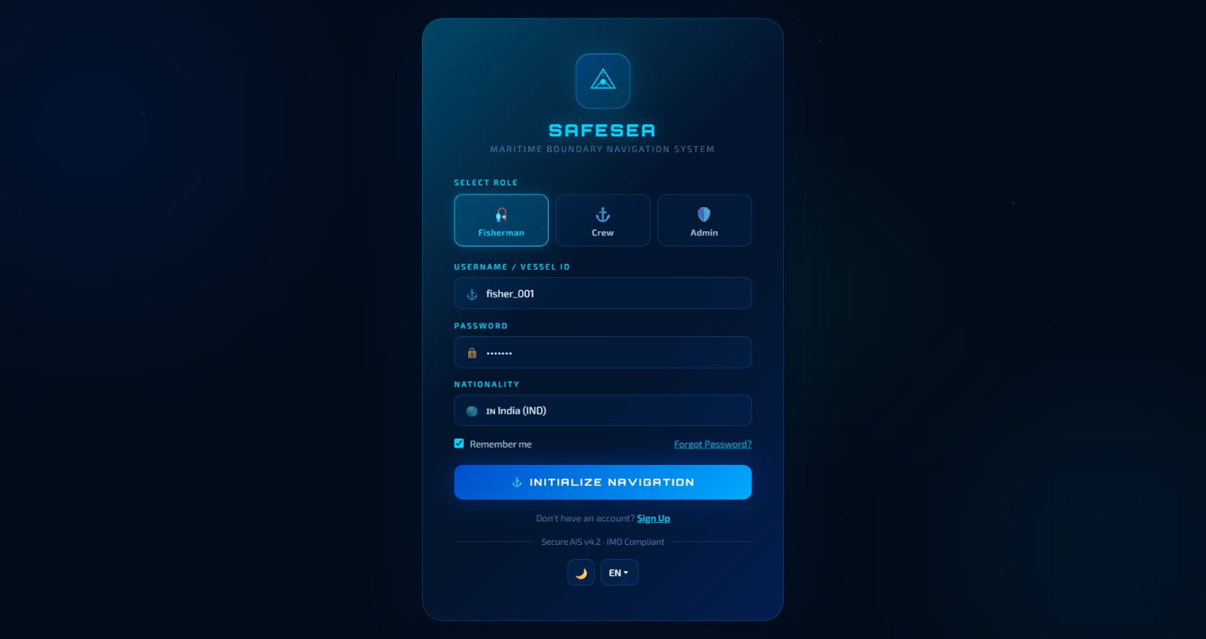
SYSTEM LOGIN PARAMETER
Role-based access for Fisherman, Crew and Admin with vessel identity and nationality selection.
Supports SDG 14 by enabling accountable and safer fishing-vessel access before navigation.

Slide 13
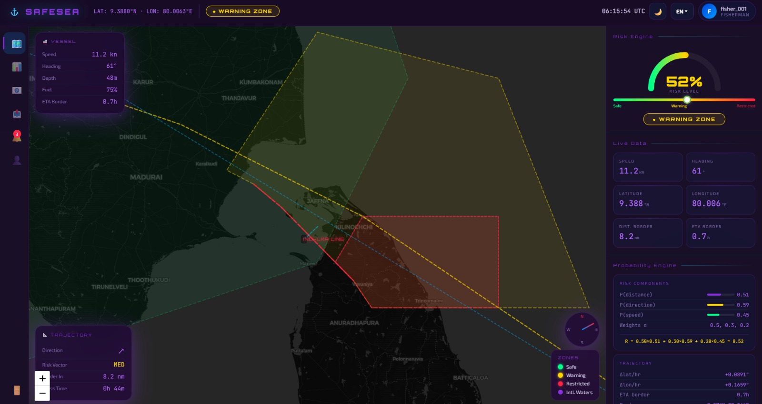
LIVE MAP: WARNING ZONE
Dashboard view showing vessel metrics, boundary distance, and medium risk-level monitoring.
Supports SDG 14 by warning fishermen before entering risky or protected maritime zones.

Slide 14
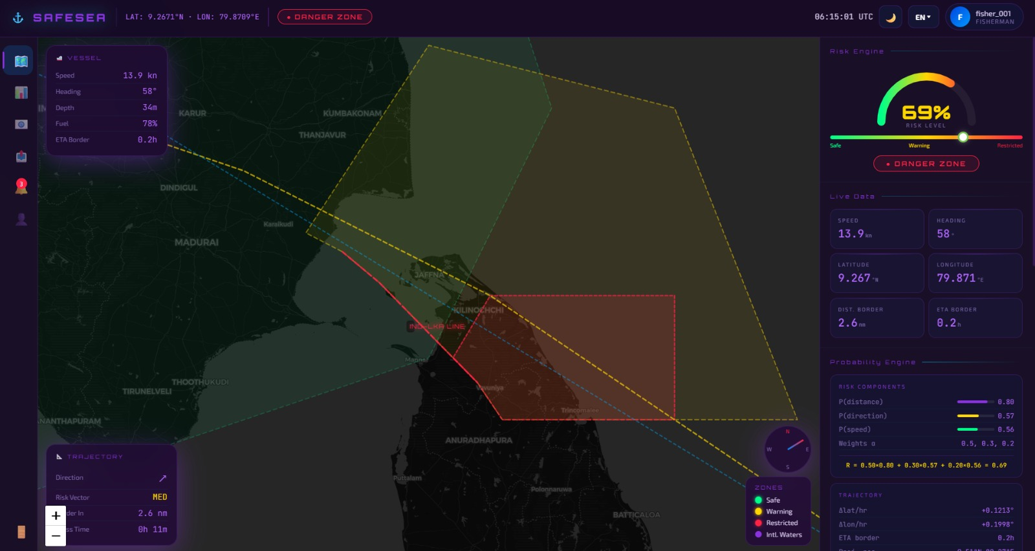
LIVE MAP: DANGER ZONE
Dashboard view showing restricted-zone risk, probability engine, and emergency decision support.
Supports SDG 14 by reducing accidental boundary violations and improving marine-safety response.

Slide 15
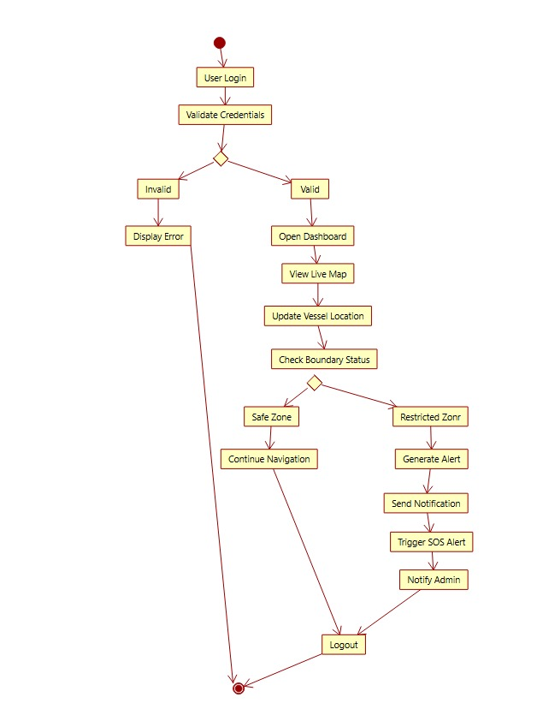
ACTIVITY DIAGRAM
Flow of login, live map navigation, boundary checking, alert generation, SOS and logout.
OOAD view: describes the operational workflow from authentication to alert handling.

Slide 16
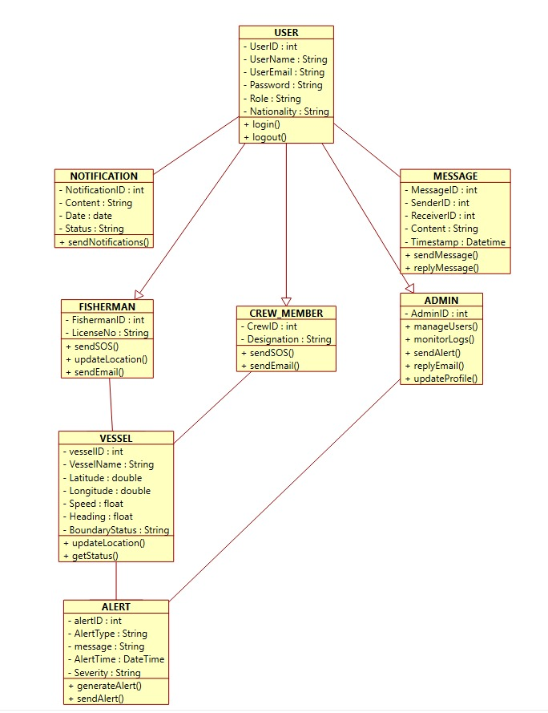
CLASS DIAGRAM
Core classes such as User, Fisherman, Vessel, Alert, Notification, Message, Crew Member and Admin.
OOAD view: shows how SafeSea entities and responsibilities are structured.

Slide 17
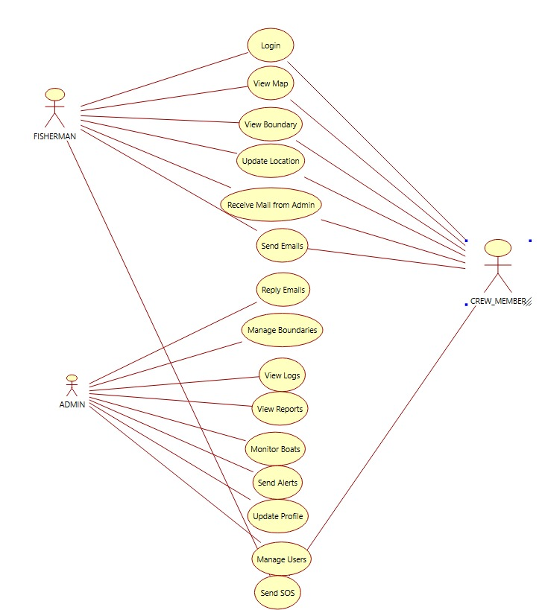
USE CASE DIAGRAM
Actors and system functions for Fisherman, Crew Member and Admin.
OOAD view: maps user interactions such as view map, manage users, send alerts and send SOS.

Slide 18
CONCLUSION
SafeSea provides an intelligent solution for preventing accidental maritime boundary crossings
The system integrates real-time monitoring and decision-support mechanisms for safer navigation
Alert mechanisms and multilingual communication improve user safety and awareness
Scalable architecture and modern software engineering practices enhance reliability
Overall, SafeSea contributes to secure and efficient maritime operations for fishermen

Slide 19
REFERENCES
Del Prete, R., Salvoldi, M., Barretta, D., Longépé, N., Meoni, G., Karnieli, A., Graziano, M. D., & Renga, A. (2024). Enhancing maritime situational awareness through end-to-end onboard raw data analysis.
Xie, Z., Tu, E., Fu, X., Yuan, G., & Han, Y. (2025). AIS data-driven maritime monitoring based on transformer: A comprehensive review.
Huang, J., Wang, A., Sun, G., Li, J., Wang, J., Niyato, D., & Leung, V. C. M. (2025). Low-altitude friendly-jamming for satellite-maritime communications via generative AI-enabled deep reinforcement learning.
Huang, J., Wang, A., Sun, G., Li, J., Wang, J., Yuan, W., Niyato, D., & Wang, X. (2025). Secure low-altitude maritime communications via intelligent jamming.
Akdeniz, G., & Nakilcioglu, E. C. (2026). Generating realistic, protocol-compliant maritime radio dialogues using self-instruct and low-rank adaptation.
Vasstein, K., et al. (2025). PyGemini: Unified software development towards maritime autonomy systems.

Slide 20
THANK YOU

